Slide 1
SalUn Experiments

Slide 2
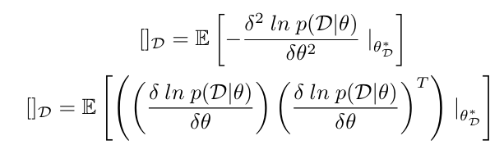
Review (1/2) – Hessian and the Fisher information matrix
Hessian
Hessian = FIM
데이터 D에 대한 파라미터의 기울기 변화량의 분포 기대값을 계산.
FIM
p(D∣θ): 데이터 𝐷와 파라미터 𝜃의 확률 분포
𝜃𝐷∗: 데이터 𝐷로 최적화된 파라미터

Slide 3


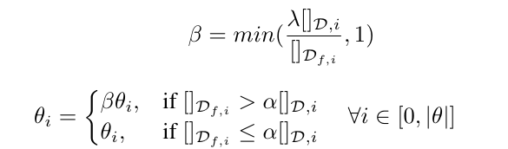
Review (1/2) – Selective Synaptic Dampening
naive
i번째 파라미터, 잊어야 할 파라미터는 0
selective
Remain dataset보다 Df에 연관된 파라미터는 0
dampening

Slide 4
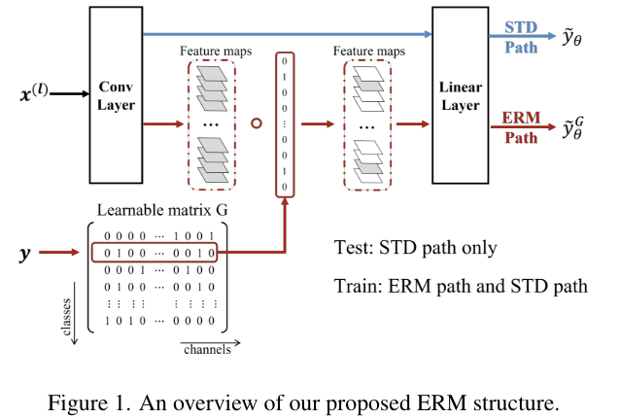
Review (2/2) – ERM

Slide 5


Review (2/2) – ERM
Learnable matrix G, c = class, k = channel

Slide 6
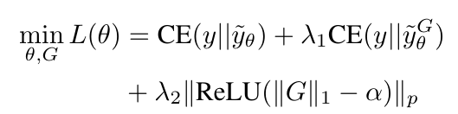
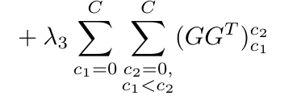
Review (2/2) – ERM
regulation term to encourage the sparsity of the matrix

Slide 7
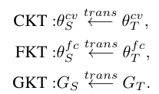
Review (2/2) – KTP
convolution layers (θ cv S and θ cv T ) knowledge transfer (CKT);
fully connected layers (θ f c S and θ f c T ) knowledge transfer (FKT);
matrix G (GS and GT ) knowledge transfer (GKT).

Slide 8


Review (2/2) – KTP
Naïve in CKT
Class c, Channel i
1인 경우 0 -> prohibit knowledge
f = original, g = unlearned

Slide 9
SalUn Experiment
Dataset - CIFAR 10
Forgot – 10%
Experiment
Origin model – Resnet 18, epoch 100 (182 in paper)
RL (+ ms) – epoch 10 (same with paper)
FT (+ ms) – epoch 10 (same with paper)
Retrain – epoch 10 (colab computing source problem)

Slide 10
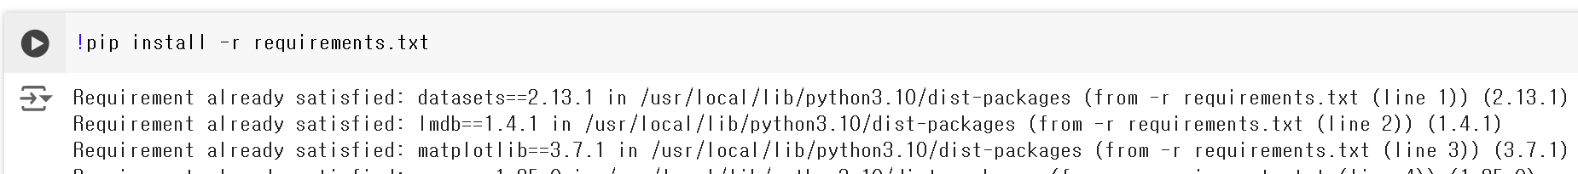
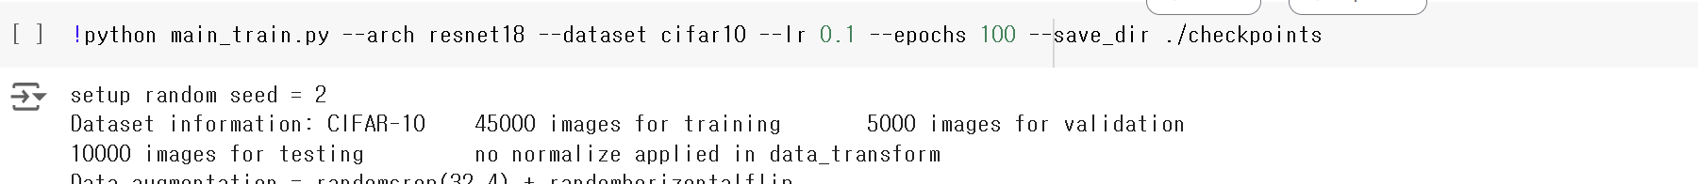
SalUn Experiment

Slide 11
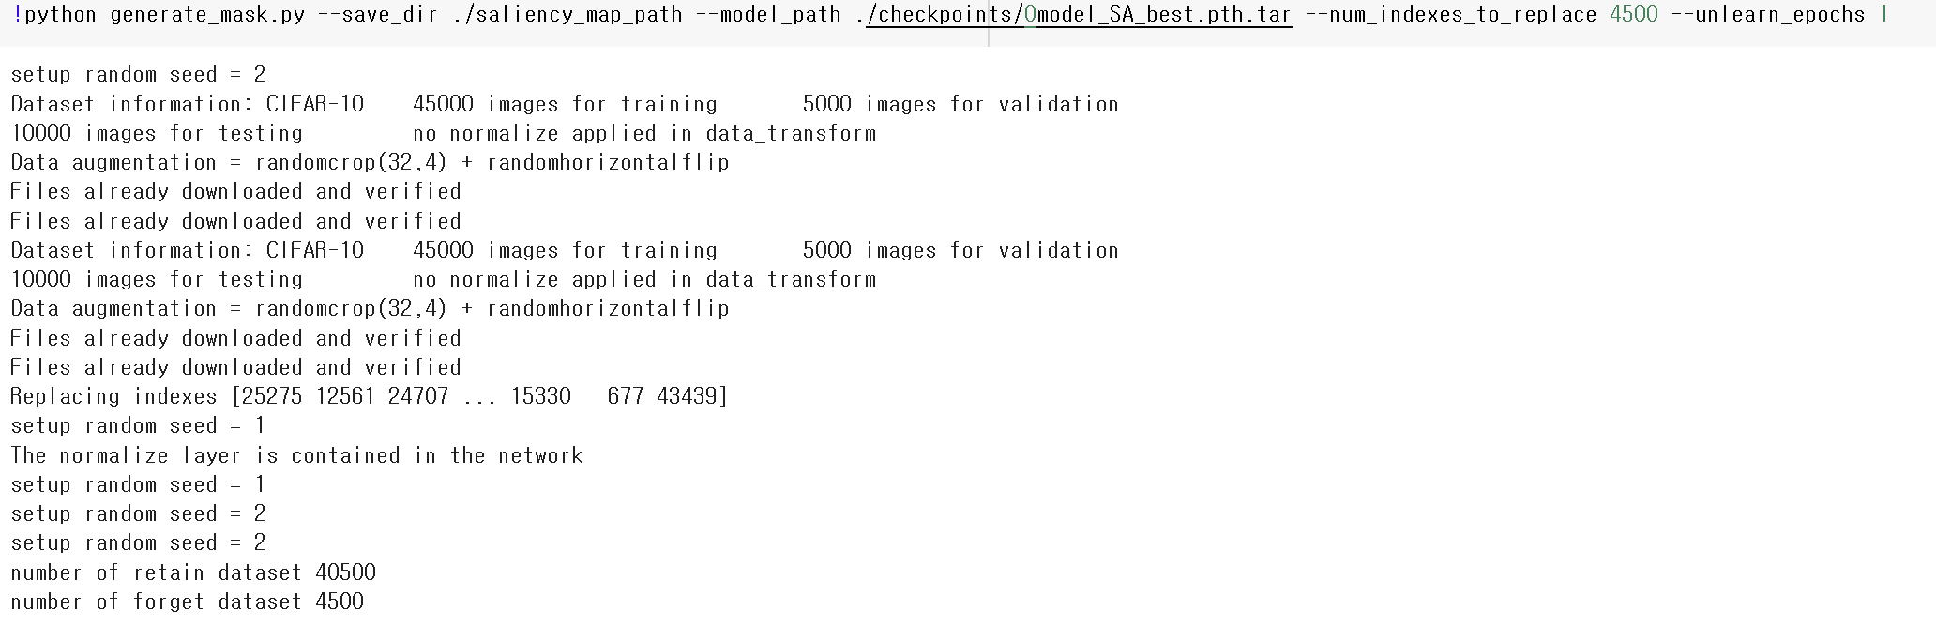
SalUn Experiment

Slide 12
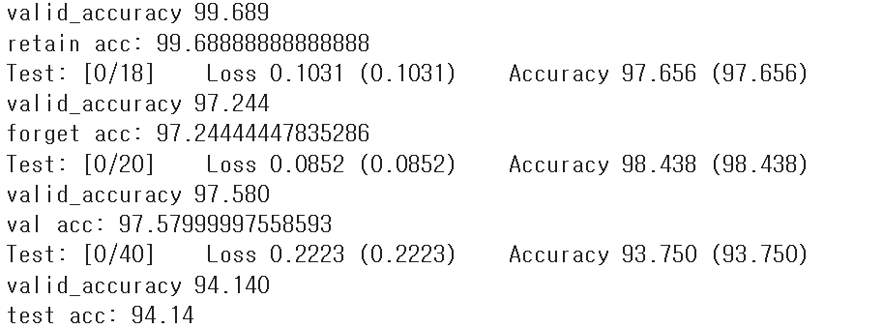
SalUn Experiment – RL + ms
!python main_random.py --unlearn RL --unlearn_epochs 10 --unlearn_lr 0.013 --num_indexes_to_replace 4500 --model_path ./checkpoints/0model_SA_best.pth.tar --save_dir ./save_dir --mask_path saliency_map_path/with_0.5.pt
Dataset information: CIFAR-10 45000 images for training 5000 images for validation 10000 images for testing

Slide 13
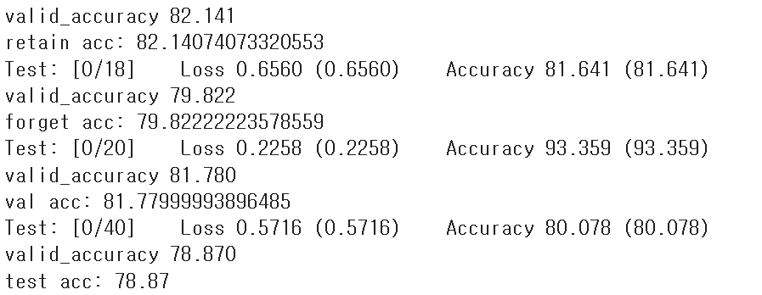
SalUn Experiment - Retrain
!python main_random.py --save_dir ./retrain --model_path ./checkpoints/0model_SA_best.pth.tar --unlearn retrain --num_indexes_to_replace 4500 --unlearn_epochs 10 --unlearn_lr 0.013 --mask_path saliency_map_path/with_0.5.pt
논문에선 train과 같은 epoch 182.
Retrain은 계산량이 많다는 결론

Slide 14
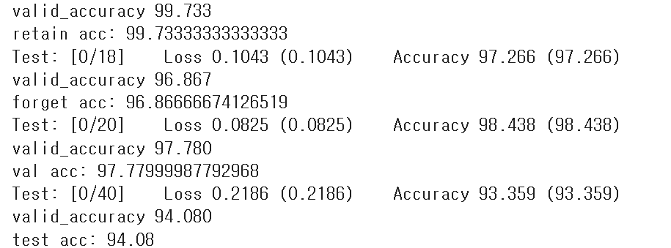
SalUn Experiment – RL
!python main_forget.py --save_dir ./RL2 --model_path ./checkpoints/0model_SA_best.pth.tar --unlearn RL --num_indexes_to_replace 4500 --unlearn_epochs 10 --unlearn_lr 0.013
RL
RL + ms

Slide 15
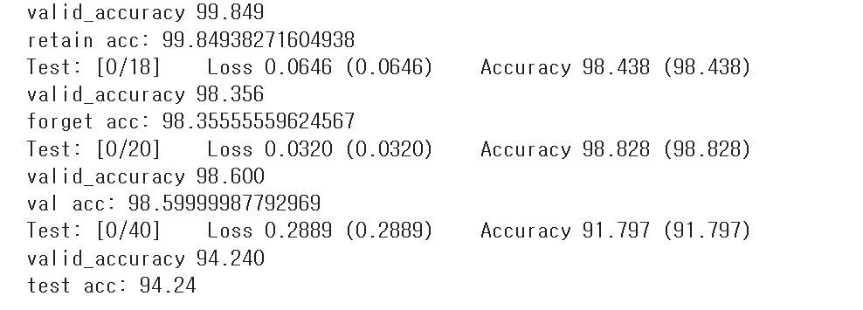
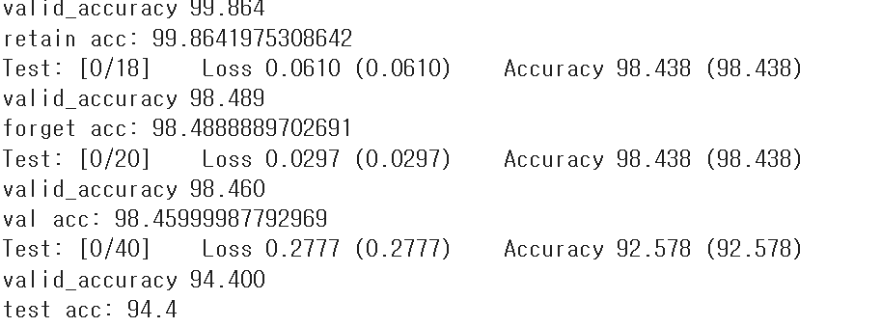
SalUn Experiment – FT
FT
FT + ms

Slide 16
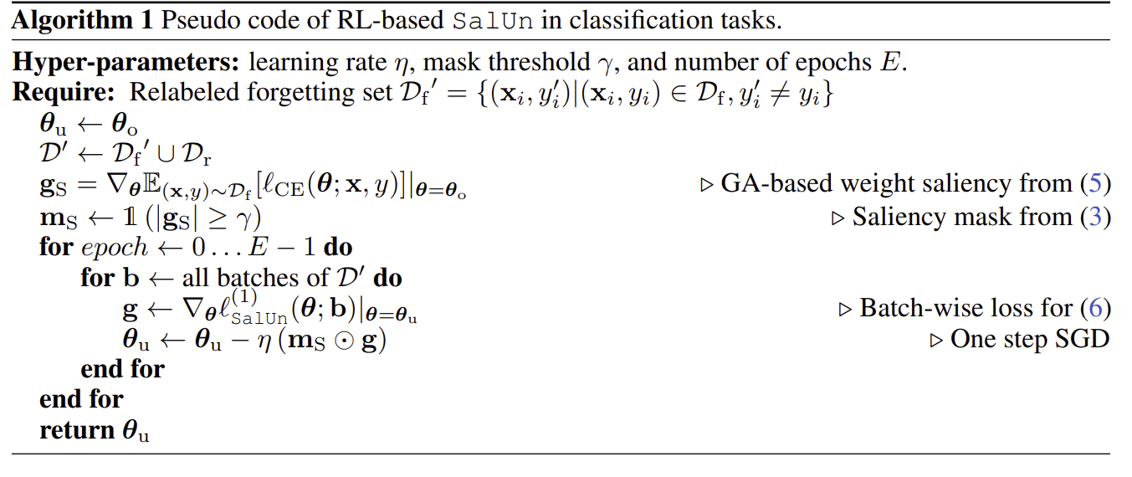
SalUn

Slide 17
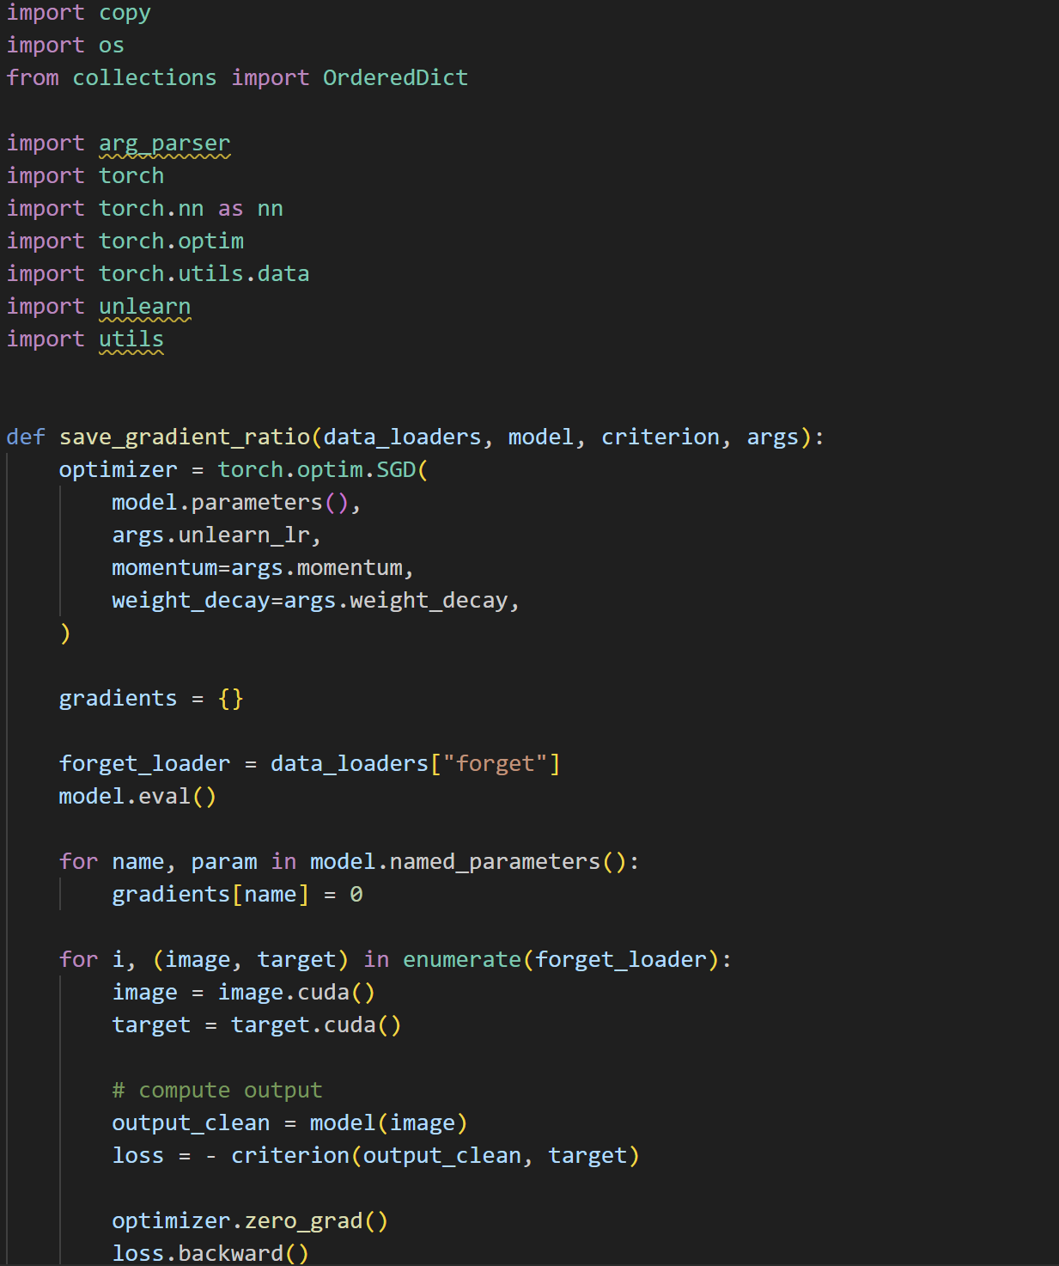
SalUn - ms

Slide 18
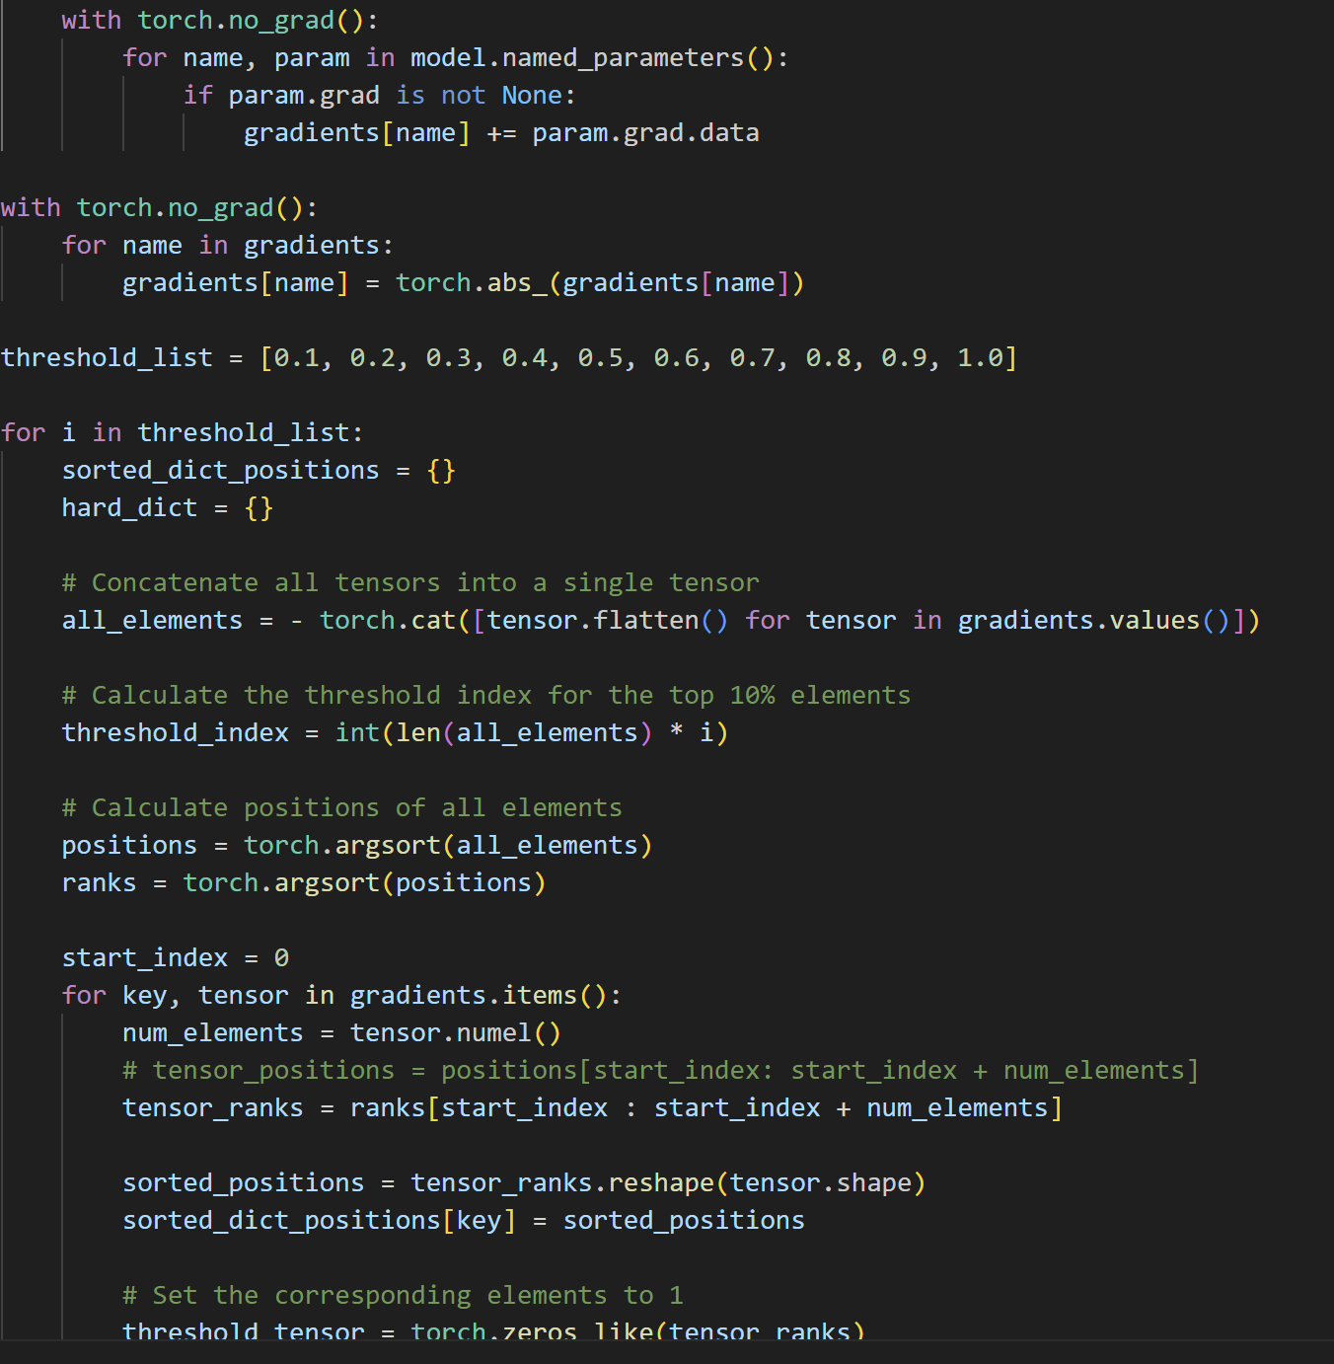


Slide 19
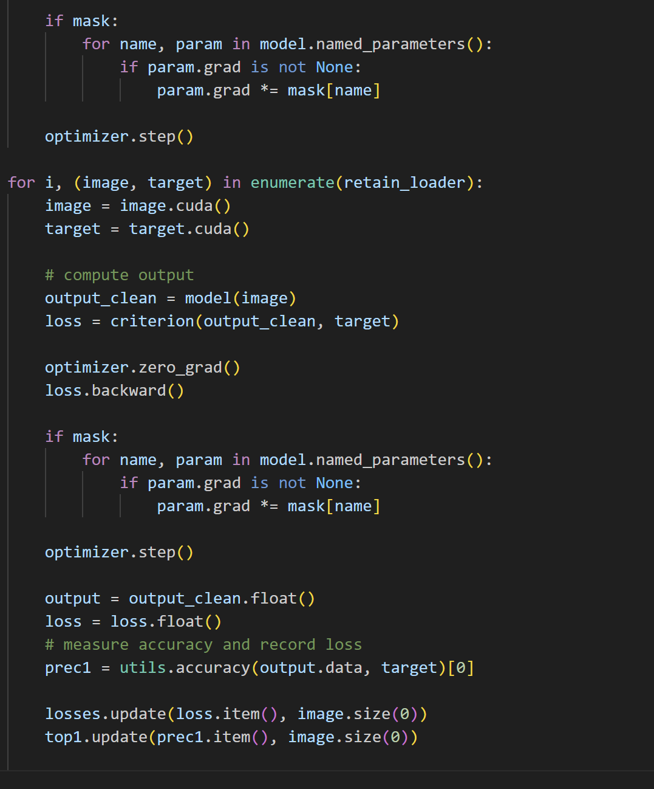
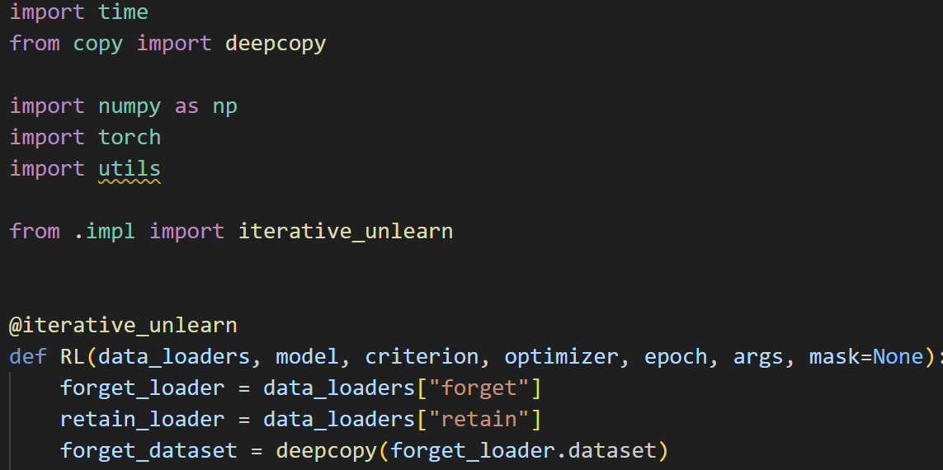
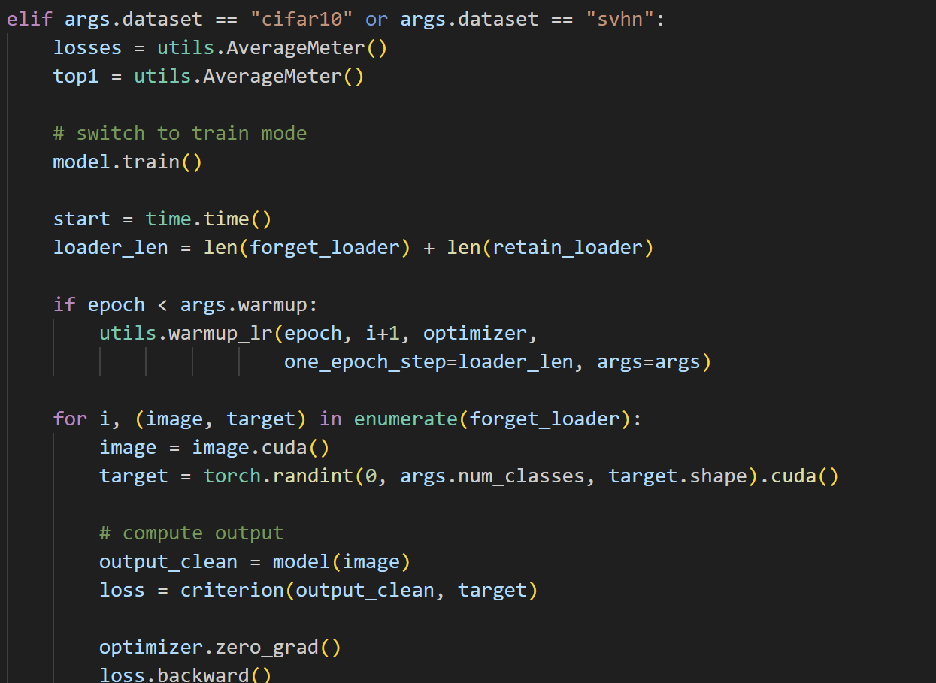
SalUn - RL

